Slide 1
Analyst Coverage Networks and Corporate Financial Policies
Armando Gomes
Radhakrishnan Gopalan
Mark T. Leary
Francisco Marcet
Management Science
September 2024
Presented by: Yan Li

Slide 2
Research Question:
Are sell-side analysts an important mechanism underpinning peer effects in financial policy choices?

Slide 3
Prior Literature
The literature exploring the role of peer effects, or the interaction among agents, in corporate finance: Shue (2013), Leary and Roberts (2014), Kaustia and Rantala (2015), Fracassi (2017), Grennan (2019), Matvos and Ostrovsky (2010), and Pool et al. (2015)
Some studies have shown evidence that analysts produce value-relevant information about the firms they cover (Womack 1996, Barber et al. 2001, Jegadeesh et al. 2004).
In addition to communicating information to investors, analysts also influence outcomes at the firms they cover. This can happen through analysts’ monitoring role (Chen et al. 2015), catering to analysts’ preferred policies (Degeorge et al. 2013), or learning from analyst feedback (Bae et al. 2022).

Slide 4
Data & Sample
Financial information: Compustat
Stock price information: the Center for Research in Security Prices (CRSP)
Analyst coverage information: the Institutional Brokers’ Estimate System (IBES)
How to identify an analyst as following a firm in a fiscal year?
If that analyst makes at least one earnings forecast during the year, and the forecast is made at most six months before and three months after the end of the fiscal period.
In which situation a pair of firms are considered to be connected through the analyst?
If the analyst follows the pair of firms for at least two years in the entire sample
Final sample spans the period 1993–2015 and includes 41,411 firm-year observations.

Slide 5
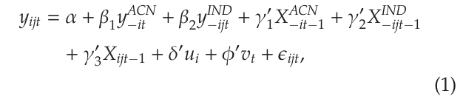





Empirical Methodology
The dependent variable: Leverage, ∆Leverage, Net Debt, Net Equity, and Gross Equity
X_{ijt-1}: the set of firm-specific controls
y^{ACN}: the weighted average value of the outcome variable for all the firms that are connected to firm i through common analysts in year t
The weights for each firm l in the analyst network: the number of common analysts between firm l and firm i
n_{ilt} represents the number of common analysts between firm i and firm l
the equally weighted average return of all firms in the analyst network of firm i
the weighted average equity shock for the analyst network; used as an instrument for

Slide 6
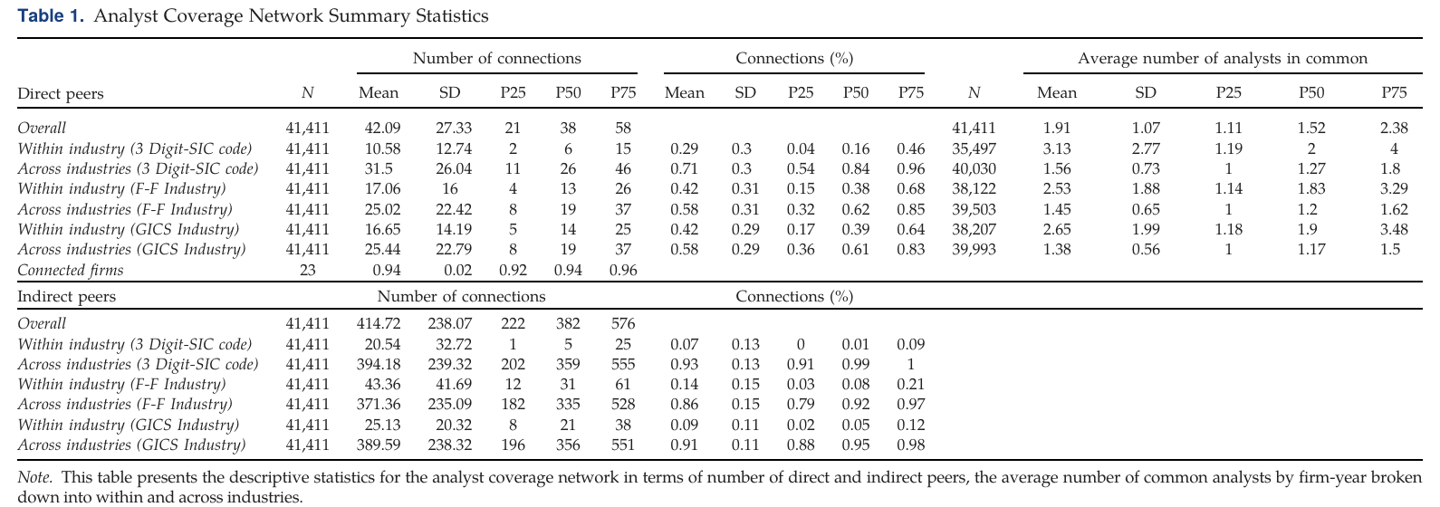
Summary Statistics
Table 1 provides descriptive statistics for the analyst networks.

Slide 7
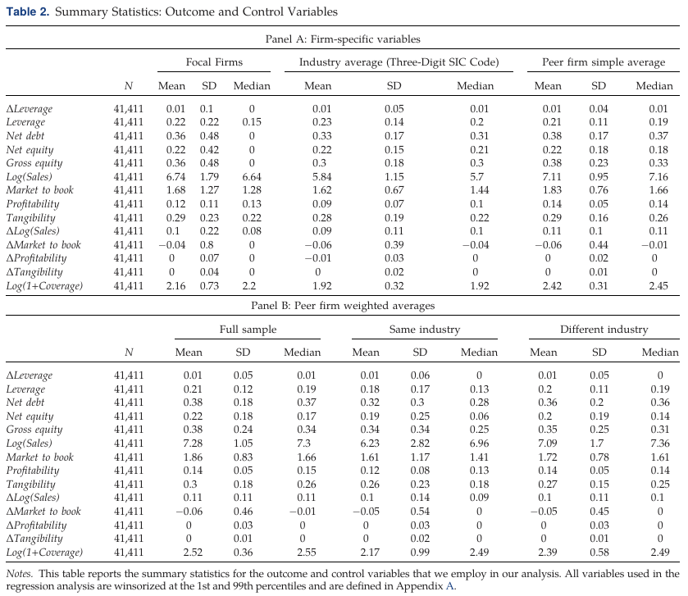
Summary Statistics
the average Leverage (change in Leverage) for the firms in the sample is 22% (1%)
firms issue debt during 36% of the firm-years
Net equity: firms issue equity in 22% of firm-year
Gross equity: equity issuances occur in 36% of the firm-years

Slide 8
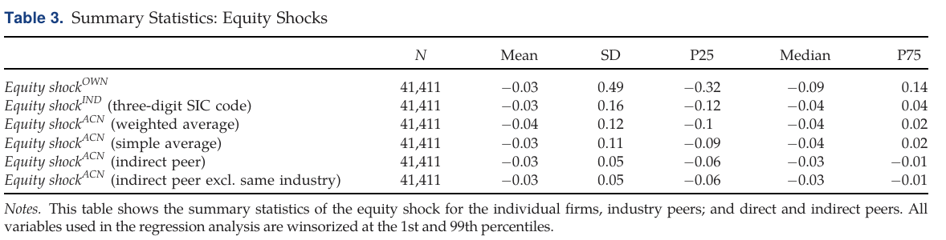
Summary Statistics
Although the average value of the own firm’s equity shock in the sample is close to zero at -0.03, it has sufficient dispersion with a standard deviation of 0.49. As expected, the dispersion declines when the equity shock is averaged over either the industry or analyst peer firms

Slide 9
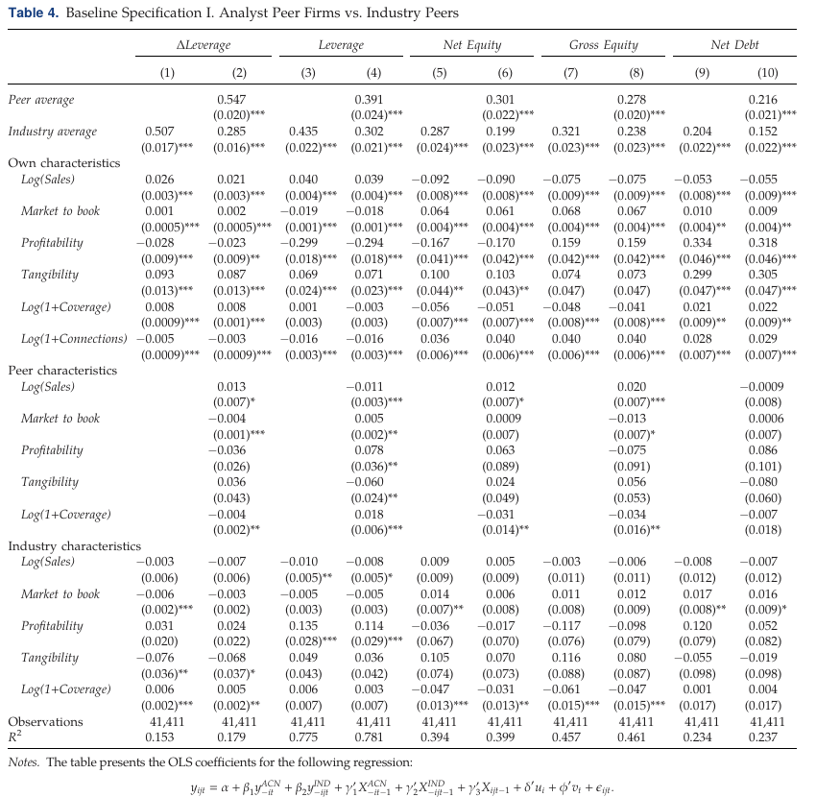
Baseline Regressions
Peer average = the weighted average leverage of all firms in the analyst network
The positive and significant coefficient on Industry average highlights the positive association between a firm’s leverage and average leverage of other firms in its industry
The firm financial policies are positively related to the financial policies of firms that are connected through common analysts. The magnitude of the association is greater than that between firm financial policy and industry average financial policies.

Slide 10
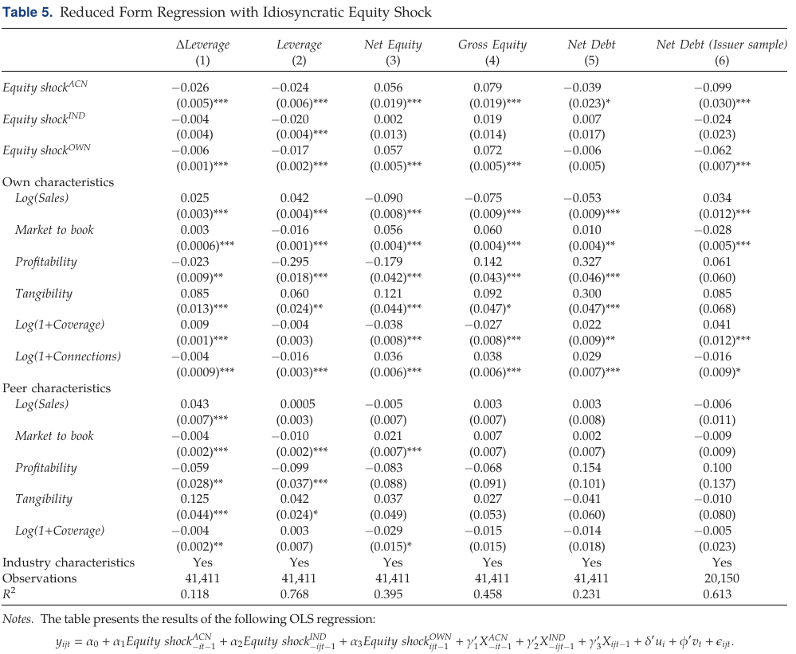
Reduced Form and Structural Regressions
The industry average shock becomes statistically insignificant once we control for Equity shock ^{CAN}
The coefficient of the peer firm equity shock on leverage is negative, although the statistical significance is weak.
There appear to be strong social effects within analyst networks for leverage, equity issuance, and security choice decisions.

Slide 11
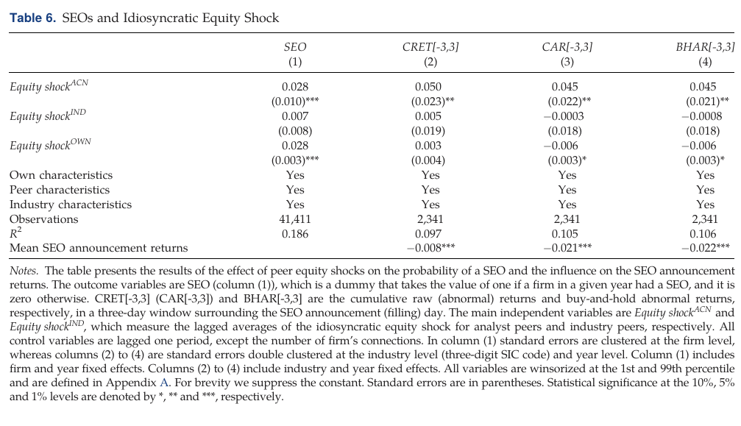
Reduced Form and Structural Regressions
Firms are influenced by their analyst network peers when making SEO (seasoned equity offering ) decisions.
SEOs that follow those of analyst network peers appear to be associated with higher announcement returns

Slide 12
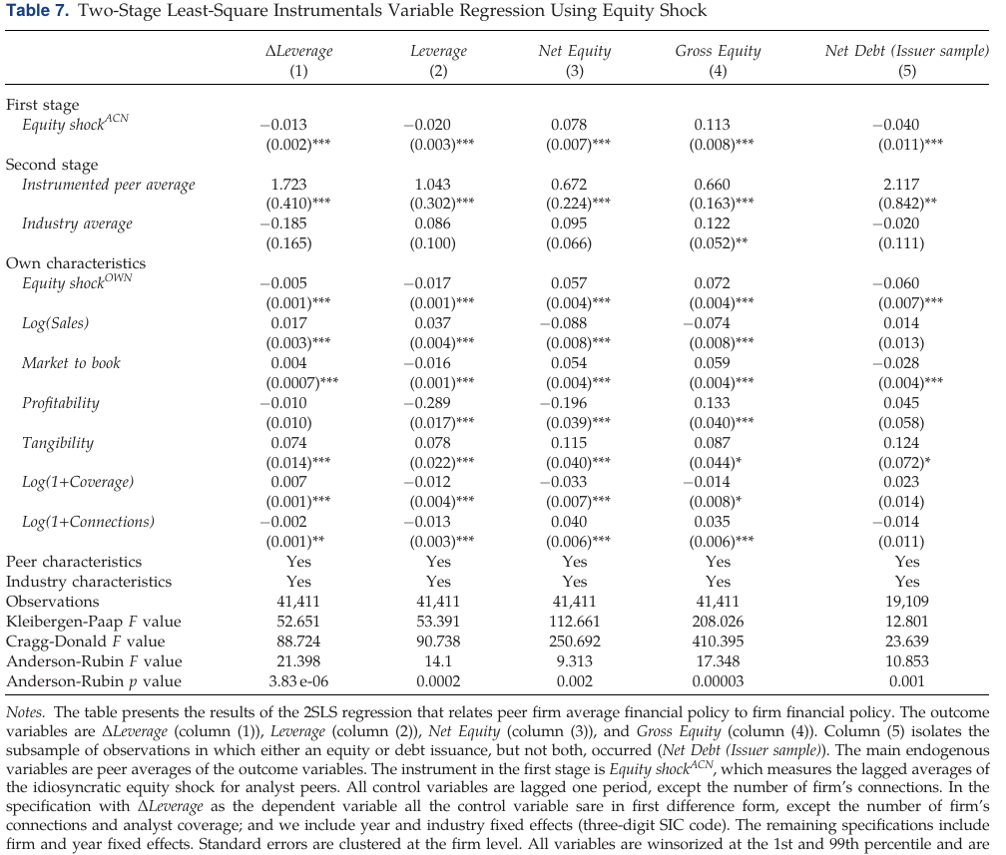
Reduced Form and Structural Regressions
Column (1) & (2): the coefficient on the instrumented peer average leverage is positive and significant
Columns (3) and (4):
The decision of peer firms to issue equity in a year is associated with the own firm’s decision to issue equity. The effect of analyst peers is greater than the effect of industry peers.
Column (5) similarly find a significant positive relation between the debt-equity choice of analyst network peers and a firm’s own debt-equity choice.

Slide 13
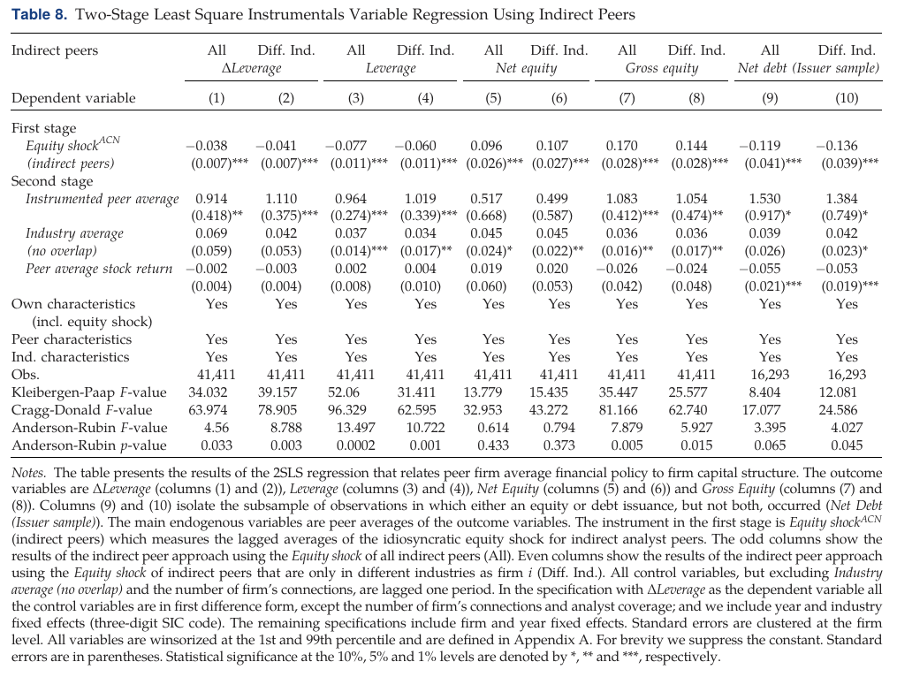
Indirect Peer Approach
Odd numbered columns include all indirect peers.
Even numbered columns excludes all indirect peers in the same industry as firm i.
There’s a significant relation between a firms’ financial policies and those of their direct peers for both the change and the level of leverage, gross equity issuances, and the debt- equity choice

Slide 14
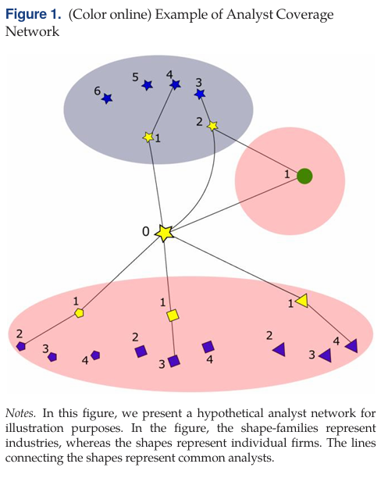

Distinguishing Analyst Network Effects from Industry Peer Effects
Pseudo Peers: in the same industry as the peer firms in the analyst network, but do not share a common analyst with firm i.

Slide 15
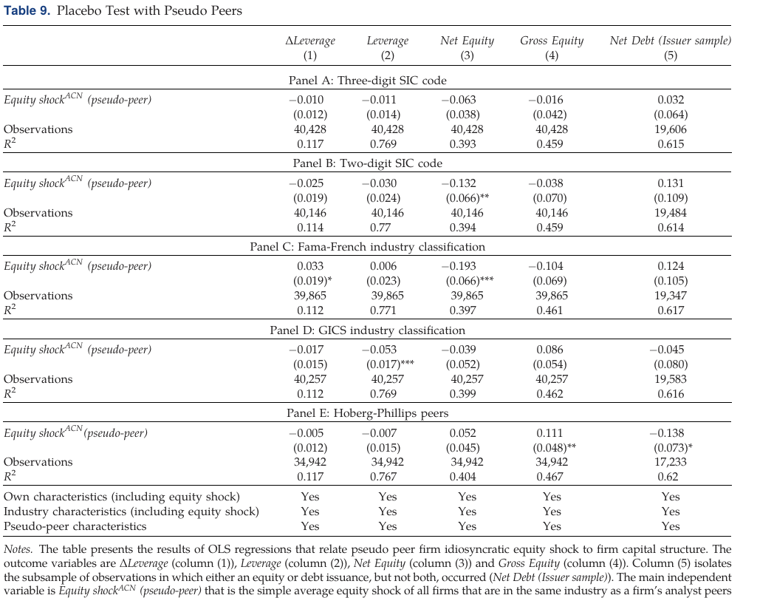
Distinguishing Analyst Network Effects from Industry Peer Effects
There is no significant relationship between the equity shocks of pseudo-peers and a firm’s financial policy.
It suggests that the previous results were not simply driven by economic connections between industries, but that analyst networks play a particular role in propagating financial policies across firms.

Slide 16
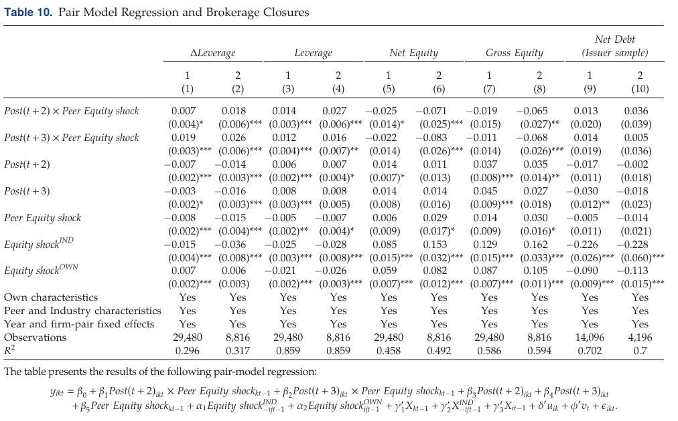

Exogenous Variation in Common Analysts
Even Columns: pairs of firms that were connected by one analyst who stopped the coverage of at least one of the two firms (i and/or k) as a consequence of the brokerage closures/mergers
Odd Columns: pairs of firms that were connected by one analyst who stopped following firm i and firm k at the same time; stronger effects
After brokerage closures/mergers and the attendant reduction in common analysts, there is a reduction in the influence of peer firms. This effect is more pronounced when common analysts stopped their coverage of both firms simultaneously

Slide 17
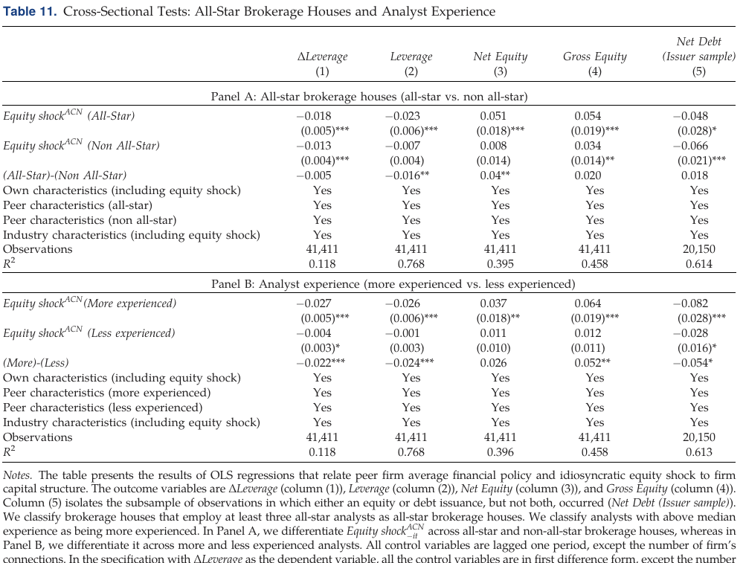
Analyst Influence
Connections through all-star analysts may be more influential for equity issuance decisions than for debt decisions
Overall:
There are stronger peer effects among firms that are connected through all-star analysts and more experienced analysts

Slide 18
Conclusions
Exogenous changes to financial policies of firms covered by an analyst, such as leverage and equity issuance, lead other firms covered by the same analyst to make similar changes in policy
The network effects are distinct from industry peer effects and that these effects are more pronounced among peers connected by analysts that are more experienced and from more influential brokerage houses
The peer effects are weaker after the reduction in common coverage as a consequence of brokerage closures

Slide 19
Thank you!

